Slide 1
Pattern Analysis and Recommendations
Team: The Alpha Clan

Slide 2
Introduction
The banks have direct access to a wealth of historical data regarding the customer spending patterns.
The Banks know how much money a customer were paid as a salary any given month, how much went to the saving account, how much went to the utility providers, etc.
Applying filters like festive seasons and macroeconomic conditions the banking employees can understand if the customer’s salary is growing steadily and if the spending remains adequate.
The above data acts as an cornerstone factors for risk assessment, loan screening, mortgage evaluation and cross-selling of multiple financial products like insurance.

Slide 3
Applications
Transaction Analysis
Money Management
Fraudulent Detection.
Analyzing the customer transactions.
Analyzing the type of the customer based on there spending and other factors.
Categorizing and analyzing the spending of the customer.
Analyzing the goals of the customer.
Predicting the right time to achieve it.
Creating a saving plan that will help to achieve the customer goal.
Analyzing the customer ATM withdrawal transactions.
Alerting the customer with an OTP to complete the transaction if the amount withdrawn is more than the average amount withdrawn.

Slide 4
Screening for the Loan Approvals.
Better offers and Deals.
Analyzing the spending patterns and previous credit history of a customer can help rapidly assess the risks of issuing a loan.
Analyzing the Spending transactions of the customer and offering better deals and offers for the customer.
Precise analysis of the customers’ financial backgrounds ensures the bank is able to cross-sell auxiliary products more efficiently and better engage the customers with personalized offers.

Slide 5
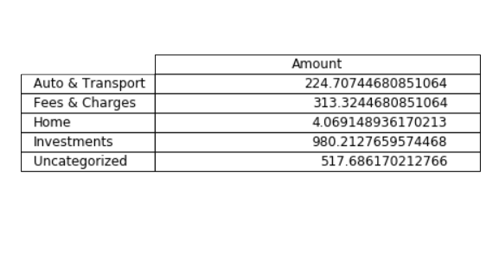
Money Management
To achieve the goal
The spending of the customer is analyzed over the period of time and it is broadly categorized as shown in the figure.
As shown in the figure the amount of money to be saved in the each category in order to achieve the goal

Slide 6
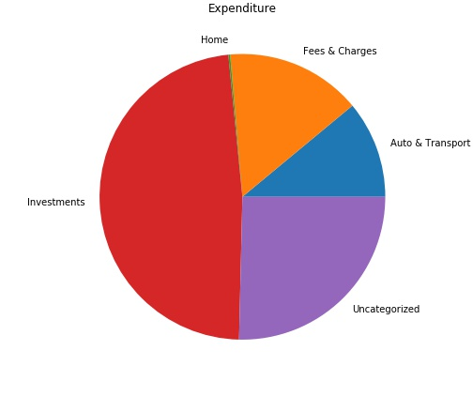
The Customer has spent most of his money in the investment and in the uncategorized category

Slide 7
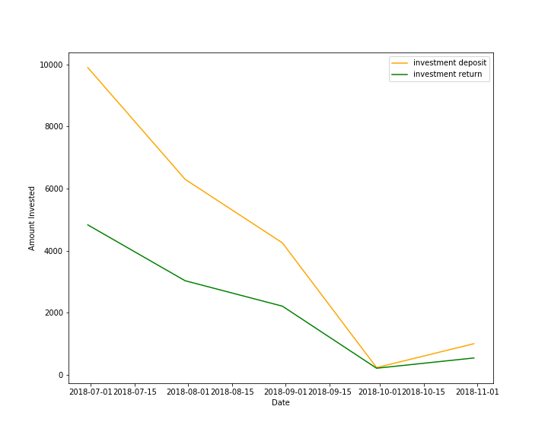

Slide 8
THANK YOU

Slide 9
Format/styling for tables
 | JANUARY | FEBRUARY | MARCH | BRAND DAY 30TH APRIL | MAY
SALES ENABLEMENT | HALO BRAND VIDEO PPT TEMPLATE SALES PLAYBOOK | SALES TRAINING ON HALO AND PLAYBOOK | REVISED HALO ADDITIONAL SALES TOOLS | FINAL PPT TEMPLATE NEW FONT ADDITIONAL SALES TOOLS | ADDITIONAL SALES TOOLS
BRAND GUIDELINES | INTERIM GUIDELINES | REVIEW BOARD COMMENCES |  | FINAL GUIDELINES INCLUDING TONE OF VOICE LAUNCHED
EVENTS | NRF – NEW YORK | EURO CIS - GERMANY | RETAILTECH - JAPAN | PT EXPO – GENEVA
 |  |  |  | PARTNERCONFERENCE – LAS VEGAS
TRAINING |  | MARKETING TRAINING ON BRAND |  | BRAND TRAINING ON VIDEO FOR ALL EMPLOYEES
VIDEO |  | BRAND VIDEO 2 (INTERNAL) |  | ROLL OUT
BRAND AMBASSADORS | COMPETITION | SELECTION | TRAINING | MULTI-CHANNEL COMMS DELIVERY | ROLL OUT
INTERNAL COMMUNICATION |  | BRAND REVEAL FOR ALL EMPLOYEES | MULTI-CHANNEL COMMS DELIVERY |  | MULTI-CHANNEL COMMS DELIVERY
EXTERNAL |  |  |  |  | DIGITAL CAMPAIGN LAUNCH
EMPLOYEE SHOUT OUTS
GO DIGITAL
INSPIRE 26,000 BRAND EVANGELISTS

Slide 10

Sample text

Slide 11
Title of slide goes here
Sample text
Sample text

Slide 12
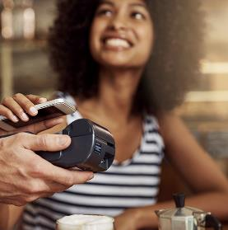

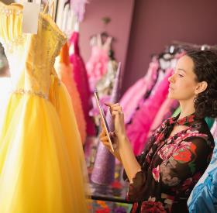

Use of squares echo the Brand Block
Sample text
Sample text
Sample text
Sample text
Sample text
Sample text
Sample text
Sample text
Sample text
Sample text
Sample text
Sample text

Slide 13



Title of slide goes here
35%
Sample text goes here
Subtitle text goes here
Body copy text goes here.
95%
Sample text goes here
56%
Sample text goes here

Slide 14

Title of slide goes here
Subtitle Text Here
Text description goes here
Subtitle text goes here
Body copy text goes here.
Subtitle Text Here
Text description goes here
Subtitle Text Here
Text description goes here
Subtitle Text Here
Text description goes here
Subtitle Text Here
Text description goes here

Slide 15

Title of slide goes here
Subtitle text goes here
Body copy text goes here.
95%
Subtitle text goes here

Slide 16






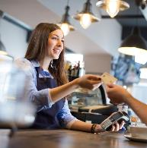


Title of slide goes here
Subtitle text goes here
Body copy text goes here.

Slide 17

Title of slide goes here
25%
Subtitle text goes here
Subtitle text goes here
Image Title Here
Body copy text goes here.
50%
Subtitle text goes here
25%
Subtitle text goes here

Slide 18

Title of slide goes here
01
Subtitle Text Here
Text description goes here
Subtitle text goes here
Body copy text goes here.
02
Subtitle Text Here
Text description goes here
03
Subtitle Text Here
Text description goes here
04
Subtitle Text Here
Text description goes here

Slide 19
Title of slide goes here
Subtitle text goes here
Body copy text goes here.
43%
43%
43%
43%
HEADER TEXT HERE
Supporting text goes here.
HEADER TEXT HERE
Supporting text goes here.
HEADER TEXT HERE
Supporting text goes here.
HEADER TEXT HERE
Supporting text goes here.

Slide 20

Title of slide goes here
Subtitle text goes here

